Slide 1

Personal Tutor Service
Team 2

Slide 2
01
About Us
02
Project Overview
Agenda
03
Demo
04
Future Work

Slide 3
Part One

Slide 4


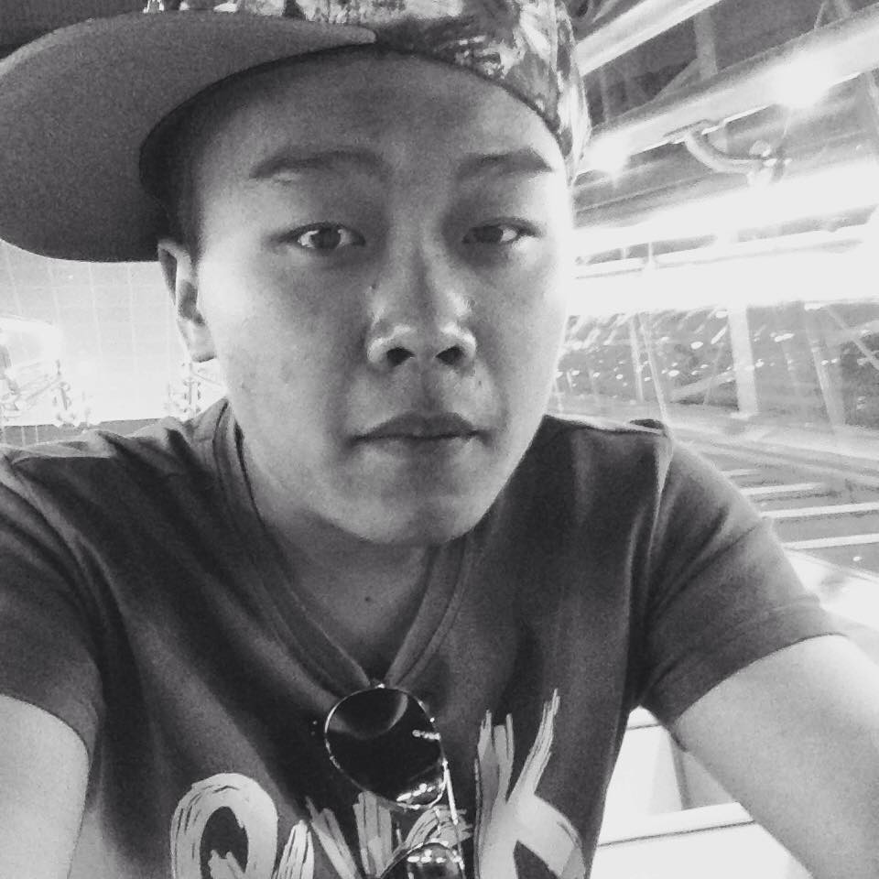
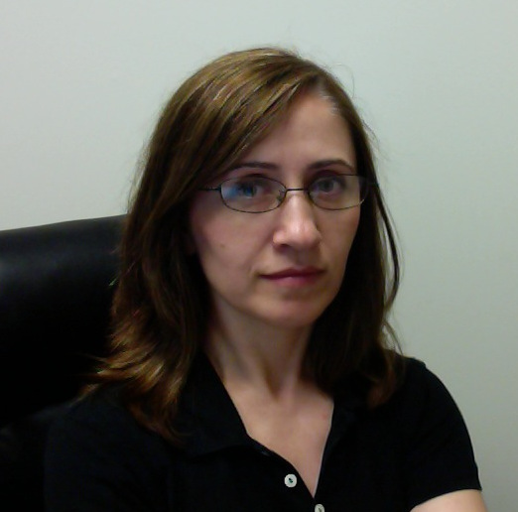
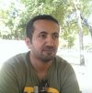
01
Who are we ?
Amy
Arun
Chris
Funda
Mousa
Shaoying Li
Arun Gopinathan
Zhenyu Chen
Funda Karapinar-Reilly
Mousa Almotairi

Slide 5
Part Two

Slide 6


02
Project Overview
Android App
1 Amazing App
Scrum Team
2 Pair Programmers
Sprint Backlog
5 Sprints
Product Backlog
9 Stories

Slide 7
02
Product Backlog
Login and Authentication(2)
Communication
(6)
Advertisement
Advertisement
(9)
Tutoring
Categories
(3)
Search(5)
Tutor
Reviews
(8)
Registration
(1)
Registration
Location(7)
Pricing and Availability(4)

Slide 8


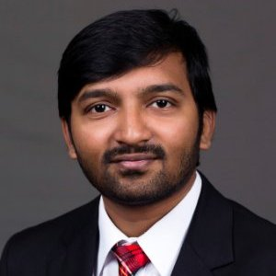
02
Sprint Backlog
ST1 (8)
ST2 (2)
20%
ST3 (3)
ST4 (5)
ST6 (2)
ST7 (10)
60%
ST8 (5) ST9 (5)
ST5 (10)
100%
50%
90%
Sprint 1
Sprint 2
Sprint 3
Sprint 4
Sprint 5
02/11-02/25
02/26-03/10
03/11-03/31
04/01-04/14
04/15-04/28

Slide 9
03
Burndown Chart

Slide 10
Part Three

Slide 11
03
Academia - Demo

Slide 12
Part Four

Slide 13
04
Future Work
Online Tutoring
Instant
Messaging
Payment
Gateway
Recommended
Courses
Social
Networks
Forums
iOS Version

Slide 14
Thank You !

